Slide 1
DATA COLLECTION AND REPRESENTATION

Slide 2
DATA
Datum: Singular, Data : Plural
A dictionary defines data as facts or figures from which conclusions can be drawn.
A collective recording of observations numerically is called data.

Slide 3
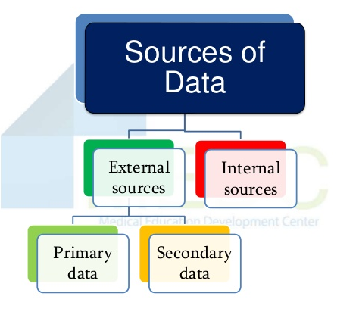

Slide 4
PRIMARY DATA
PRIMARY DATA: Primary data are original data which are collected for the first time by the investigator for the purpose of a specific statistical investigation. In the words of Wessel, “ Data originally collected in the process of investigations are known as primary data.”
Primary Data is also called as first hand data.
Eg: Personal Interview, Telephonic Interview, Questionnaire, Surveys

Slide 5
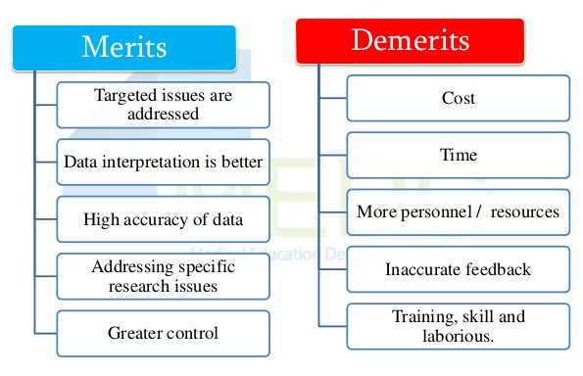

Slide 6
SECONDARY DATA
Secondary data are those data that have already been collected by others.
According to M.M.Blair , “ Secondary data are those which are already in existence, and which have been collected for some other purpose than the answering of the questions in hand.”

Slide 7
Eg: External sources like, magazines, newspapers, research articles, Internet, etc.
The merit of secondary data is that it is cheaper and easier to acquire than primary data.
Major demerit of secondary data is that the reliability, accuracy and integrity of the data is uncertain.

Slide 8
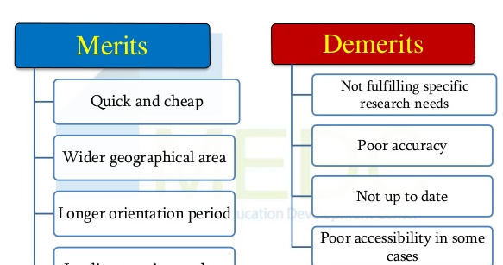

Slide 9
METHODS OF COLLECTING PRIMARY DATA
1. OBSERVATION METHOD – It is commonly used in studies related to behavioral science.
2. INTERVIEW METHOD –
a. Structured Interview
b. Unstructured Interview
c. Personal Interview
d. Telephonic Interview

Slide 10
3. QUSTIONNAIRE: Set of printed questions
4. POLLS: Polls comprise of one single or multiple choice question. Short in length.

Slide 11
METHODS OF COLLECTING SECONDARY DATA
Official publications such as the Ministry of Finance, Statistical Departments of the government, Federal Bureaus, Agricultural Statistical boards, etc. Semi-official sources include State Bank, Boards of Economic Enquiry, etc.
Data published by Chambers of Commerce and trade associations and boards.
Articles in the newspaper, from journals and technical publications.
Balance Sheet, Profit & Loss Statement, Sales Record of Organizations

Slide 12
PRESENTATION OF DATA
Presentation of data refers to an exhibition or putting up data in an attractive and useful manner such that it can be easily interpreted.
The three main forms of presentation of data are:
1.Textual presentation
2.Data tables
3.Diagrammatic presentation

Slide 13
Textual Presentation
This kind of representation is useful when we are looking to supplement qualitative statements with some data. For this purpose, the data should not be voluminously represented in tables or diagrams.
E.g.: “the 2002 earthquake proved to be a mass murderer of humans. As many as 10,000 citizens have been reported dead”.

Slide 14
Tabular Presentation
A table facilitates representation of large amounts of data in an attractive, easy to read and organized manner. The data is organized in rows and columns. This is one of the most widely used forms of presentation of data since data tables are easy to construct and read.
According to D. Gregory, “Tabulation is the process of condensing classified data in the form of a table so that it may be more easily understood, and so that any comparisons involved may be more readily made.”

Slide 15
Objectives of Tabulation
To Simplify Complex Data
To Facilitate Comparison
To Economise Space
To Depict Trend
To Detect Error and Omissions in the Data
To Facilitate Statistical Processing

Slide 16
Components of a Data table
Table Number: Each table should have a specific table number for ease of access and locating.
Title: A table must contain a title that should be clear, concise and self explanatory.
Headnotes : A headnote further aids in the purpose of a title and displays more information about the table.
Stubs: These are titles of the rows in a table. Thus a stub display information about the data contained in a particular row.

Slide 17
Caption: A caption is the title of a column in the data table. In fact, it is a counterpart of a stub.
Body or field: The body of a table is the content of a table. Each item in a body is known as a ‘cell’.
Footnotes: Footnotes are often used at the bottom of the table to point any omission or characteristic in the table.
Source: When using data obtained from a secondary source, this source has to be mentioned below the footnote.

Slide 18
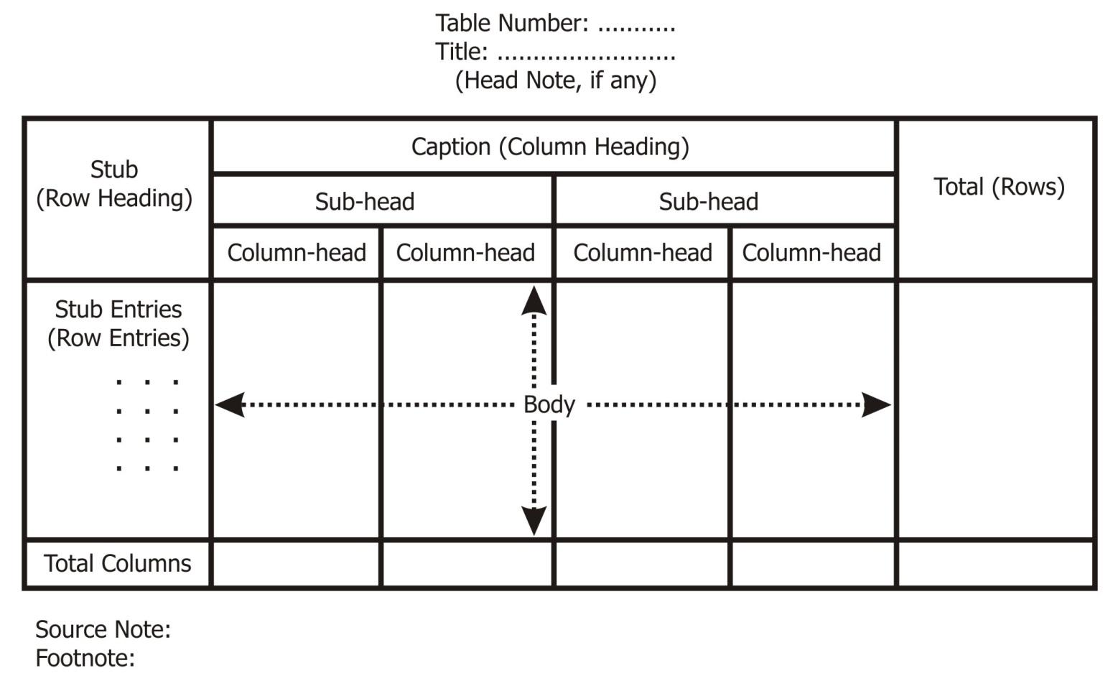
DRAFT

Slide 19
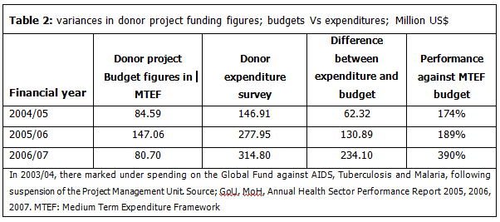
EXAMPLE

Slide 20
Eg1 : In a sample study about coffee habits in two towns, the following information was received:
Town A: Females were 40%, total coffee drinkers were 45% and male non coffee drinkers were 20%
Town B: Males were 55%, male non coffee drinkers were 30% and female coffee drinkers were 15%.
Represent this data in a tabular form.

Slide 21
Table1: Coffee Drinking Habits of Town A and B (In Percentage)
ATTRIBUTE | TOWN A |  |  | TOWN B
 | MALES | FEMALES | TOTAL | MALES | FEMALES | TOTAL
Coffee DRINKERS | 60-20=40 | 40-35=5 | 45 | 55-30=25 | 15 | 40
NON COFFEE DRINKERS | 20 | 55-20=35 | 100-45=55 | 30 | 45-15=30 | 100-40=60
TOTAL | 100-40=60 | 40 | 100 | 55 | 45 | 100

Slide 22
Eg.2: In 2000, out of a total of 1750 workers of a factory, 1200 were members of a trade union. The no. of women employees was 200, out of which 175 did not belong to a trade union. In 2002, the no. of union workers increased to 1580 of which 1290 were men. On the other hand, the no. of non union workers fell down to 208, of which 180 were men. In 2004, there were 1800 employees who belonged to a trade union and 50 who did not belong to a trade union.

Slide 23
Of all employees in 2004, 300 were women of whom only 8 did not belong to a trade union. Present the above data in a suitable tabular form.

Slide 24
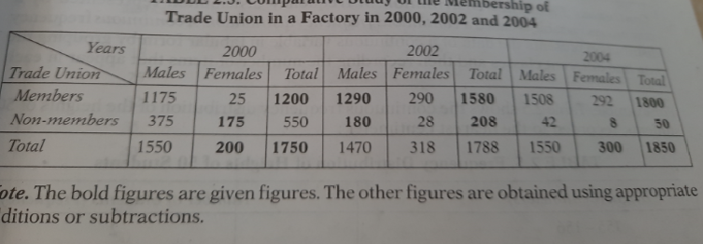
SOLUTION

Slide 25
DIAGRAMATIC REPRESENTATION OF DATA
When data is presented in a simple and attractive manner in the form of diagrams is called diagrammatic presentation of data.
It makes the presentation of data attractive and simple.

Slide 26
TYPES OF GRAPHICAL REPRESENTATION OF DATA
Line Graph
Bar Diagram
Histogram
Pie Diagram
Frequency Polygon
Frequency Curve
Ogive Curves

